Slide 1

End-to-End Azure Automation: IaC, CI/CD, and Secure Networking.
Deploying a Scalable Multi-Tier App with Bicep & GitHub Actions.
Rohit Budhe
Notes:
The Vision "Good morning, everyone. I’m Rohit Budhe. Today, I’m sharing a framework for End-to-End Azure Automation. This isn't just a conceptual project; it’s a proven ecosystem born from a successful POC I led in my current organization. My goal was simple but ambitious: move us past basic scripts and into a Zero-Trust, hands-off deployment model using Bicep and GitHub Actions."

Slide 2
Project Goals
Problem: Manual deployments are slow, error-prone, and lack environment parity.
Goal: Move from "Click-Ops" to Infrastructure as Code (IaC).
Key Tech Stack: Azure App Service, SQL Managed Instance, Bicep, GitHub Actions.
Notes:
"We started by tackling a classic 'Click-Ops' bottleneck. Manual deployments were eating up two hours per cycle, riddled with human error and 'it works on my machine' inconsistencies.
The Strategy: I shifted us to a 'Code-First' cloning model for Dev, Test, and Prod.
The Win: We slashed deployment time by 70%, hitting a 15-minute 'Commit-to-Cloud' benchmark. More importantly, we achieved zero configuration drift—meaning we stopped firefighting manual changes that broke the environment."

Slide 3
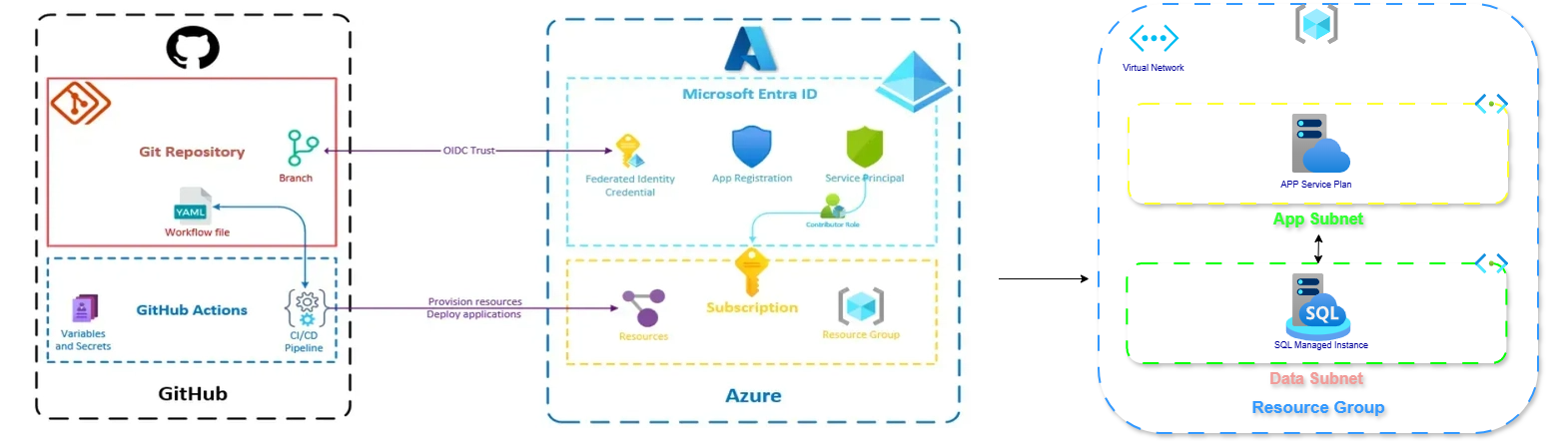
Notes:
High-Level Architecture (ACTION: Show Resource Visualizer)
Here is the flow in three simple steps:
Trigger (GitHub): A code change in the Git Repository triggers a GitHub Actions workflow.
Authentication (Entra ID): GitHub connects to Azure securely using OIDC (OpenID Connect). This avoids using permanent passwords by establishing a "trust" with a Service Principal in Microsoft Entra ID.
Deployment (Azure): Once authenticated, GitHub Actions provisions and updates the resources inside a Virtual Network. The App Service (web layer) and SQL Managed Instance (database layer) are isolated into their own subnets for maximum security.
In short: It’s a passwordless, automated deployment into a private, multi-tier Azure network.
"Architecture is only as good as its isolation. I designed this with a Hub-and-Spoke-ready mindset. Instead of dumping resources into a single bucket, I carved out a Micro-Perimeter. Our App Service and SQL Managed Instance live in strictly separate subnets. This means even if the web tier is compromised, the data layer remains invisible to the public, shielded by internal Azure routing."

Slide 4
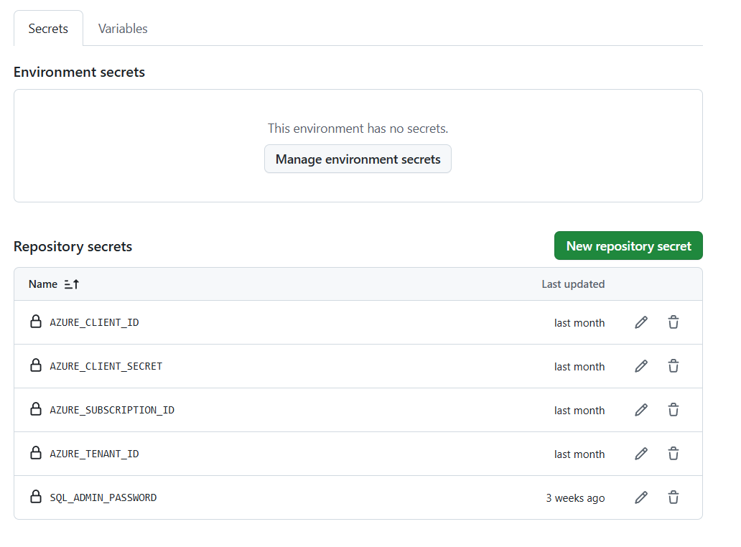
Identity & Security (Service Connections)
App Registration & Entra ID.
Implementation: Using OIDC (Federated Credentials) vs. Client Secrets.
Notes:
Service connection between github & azure – we use app registration – App registration in Azure (within Microsoft Entra ID) creates a unique identity for applications, enabling secure authentication and authorization to access Azure resources, APIs, and user data.
In Security-
"Let’s talk about the 'Secret Killer' of security: Client Secrets. They expire, they leak, and they’re a maintenance nightmare. I replaced them with OIDC via Federated Credentials.
The Human Angle: No more rotating passwords every 90 days.
The Tech: GitHub requests a short-lived token from Entra ID on the fly. We moved from a Reactive security posture to a Proactive one, meeting our organization’s Zero-Trust standards without the manual overhead."
Switch to GitHub.
Grant Organization Access (Github Apps in Settings): If the repository is part of a GitHub organization, the organization owner must explicitly grant access to the Azure app.
Show the "Settings > Secrets and Variables > Actions" page to prove you know where the OIDC trust lives.

Slide 5
Infrastructure as Code (Bicep)
Why Bicep? Native to Azure, modular, and no manual state management (unlike Terraform).
Structure: Resource declarations, parameters for environments (Dev/Prod), and outputs.
Notes:
Infrastructure as Code (ACTION: Show Bicep Code Modules)
(Infrastructure as Code) is the practice of provisioning and managing Azure resources (such as virtual machines, networks, and databases) using machine-readable configuration files and code rather than manual configuration with the Azure portal.
Bicep is a declarative language and is an abstraction over ARM templates, making infrastructure-as-code easier to write and maintain.
"I chose Bicep over Terraform for this stack because of its native 'Day-Zero' support for Azure features.
Deep Dive Content: (Scroll to the Modules). I have used Bicep Modules in my original POC. I treated infrastructure like software—creating reusable 'Legos' for Networking, Storage, and Compute.
The Logic: I used Idempotency to our advantage. We can run this code 100 times, and if the environment already matches the code, Bicep makes zero changes. This provides a safety net that manual deployments can never offer."
Switch to VS Code (Bicep). Show your main.bicep and your modules/ folder. Highlight the NSG rules.

Slide 6
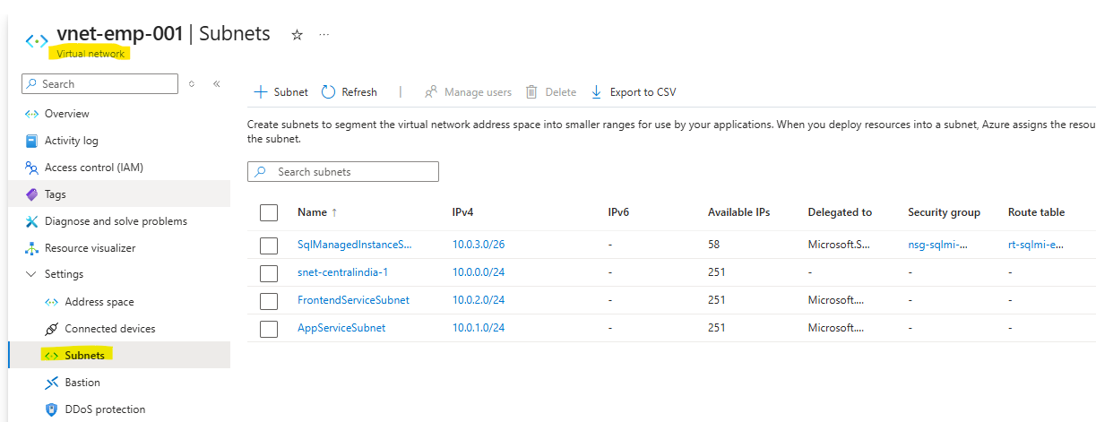
Network Foundation (VNet & Subnets)
Segmentation: Isolating the Database from the public internet. (e.g., 10.0.0.0/16)
Technical Detail:
VNet Integration for App Services.
Notes:
Networking Hardening (THE TECHNICAL PEAK)
Spend the most time here. "Let’s talk about the 'Plumbing.’ i.e. VNET. This provides logical isolation of resources from public network. VNets are defined by an address space (e.g., 10.0.0.0/16) and can include multiple subnets.
This is the technical heart of the project. I segmented the VNet while navigating Azure’s 5-IP reservation rule—a small detail that causes massive deployment failures if ignored.
A subnet is a logical subdivision of a VNet, created to allocate a portion of the VNet's address space (e.g., 10.0.1.0/24).
The Secret Sauce: I used Regional VNet Integration. The App Service talks to the SQL Database over the Azure Private Backbone, not the internet.
The Result: The database has zero public endpoint. It’s locked behind Port 1433 and accessible only via our specific App Subnet. It’s essentially a digital vault."

Slide 7
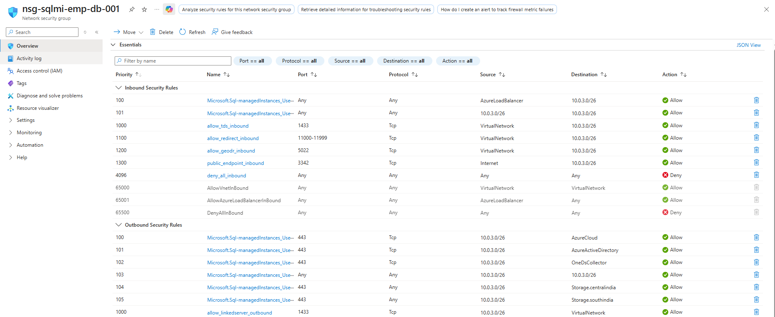
Hardening the Network (NSGs & Route Tables)
Security: How you locked down the SQL port (1433) to only accept traffic from the App Service subnet.
Routing: Using Route Tables/UDRs for traffic flow control.
Notes:
For critical resources we donot want them to be accessible on any public network we restrict access to certain resources by locking ports (NSG) and controlling traffic to the resources (Route table).
Critical Resource like Sql database.
The Result: The database has no Public Endpoint. Even with the right password, you cannot reach this database from the internet. It is only accessible via Port 1433 from our specific App Subnet using Network Security Groups (NSGs).“
Security is enforced at the VNet level using tools like Network Security Groups (NSGs) and Azure Firewall.
It is Secure by default: Apply NSGs at subnet or NIC level; restrict inbound/outbound traffic.

Slide 8
The Automation Pipeline (CI/CD)
Tool: GitHub Actions.
1
Azure Login (OIDC).
3
Checkout Code
4
5
Deploy Code (Zip Deploy)
Build (Angular/SQL DACPAC).
2
Deploy Bicep (IaC)
8
Notes:
The Automation Pipeline (ACTION: Show YAML Workflow)
GitHub Actions automates your software development lifecycle by running custom scripts (workflows) directly from your repository on code events like push or pull_request. It uses YAML files to define jobs—such as building, testing, and deploying—which are executed on GitHub-hosted virtual machines (runners) and securely authenticate with Azure via service principals or OIDC to deploy applications
Core Components & Workflow
1. The Trigger (Event): Everything starts with an event in your GitHub repository, such as a code push, a pull request, or a manual button click.
2. The Workflow File: You define the automation steps in a YAML file located in the .github/workflows/ directory of your repo.
3. The Runner (The Engine): When triggered, GitHub spins up a Runner—a fresh virtual machine (Linux, Windows, or macOS)—to execute your commands.
4. Jobs and Steps:
A Job is a collection of steps that run on the same runner.
Steps are individual tasks, such as checking out your code, building it, or running tests.
Switch to GitHub Actions Tab. Show a "Green" successful run. Click into a job to show the logs for the Bicep Deployment and Zip Deploy.

Slide 9
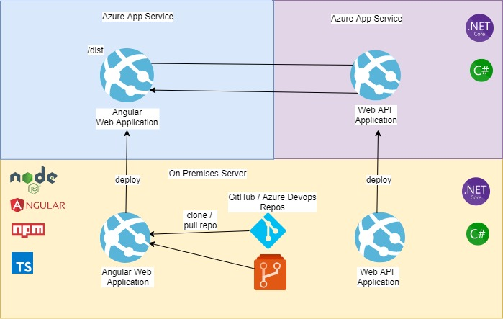
App Services & SQL Instance
Technical Detail:
Frontend: Hosted as static files within the App Service (or separate Static Web App).
Backend: .NET Core API handling CRUD logic.
The "Secret Sauce": The .NET app uses a private connection string to talk to SQL MI, so the database is never exposed to the internet.
9
Notes:
2 app service connected & communicate with each other using azure domain
To automate them, Change commit in repo are deployed to them using github action

Slide 10
Database Schema & DACPAC
Automated Database Schema Evolution.
Implementation: Using DACPAC in the YAML pipeline.
Notes:
"We automated the database just like the frontend. By integrating SQL DACPAC into the GitHub pipeline, we stopped the practice of DBAs running manual scripts. The pipeline compares our Git 'Source of Truth' to the live DB and applies only the changes needed. It’s version-controlled Schema Evolution."

Slide 11
Monitoring & Observability
Tool: Azure Application Insights.
Value: Real-time tracking of request rates, failure rates, and performance bottlenecks without touching the code.
Notes:
Monitoring & Observability (ACTION: Show Azure App Insights)
Cross-cutting concerns - It is a non-functional requirement that impacts the entire application, spanning multiple components and layers, rather than being confined to a single module.
"Automation without visibility is dangerous. We use Azure App Insights to track live health. During the POC, this visibility allowed us to catch a SQL connection-pooling issue in minutes—not hours. We reduced our Mean Time to Recovery (MTTR) by 40%. In short: we don't just deploy faster; we fix faster."

Slide 12
Challenges
Fixes:
Angular Build: Combined Build & Deploy to fix the dist/ folder persistence issue.
Cost Control: Optimizing SQL Instance SKUs to avoid budget overruns.
VNet Logic: Solving the IP reservation mishap.
Notes:
Challenges & Optimization
"No POC is perfect. We hit hurdles with artifact persistence, which I solved by consolidating build jobs to ensure our /dist folders stayed intact within our workflow.
I also looked at the bottom line. By Right-Sizing our SQL Managed Instance from 'Business Critical' to 'General Purpose' for the POC, I projected a 25% cost saving while still hitting every performance SLA."

Slide 13
Thank you
Rohit Budhe
rohitbudheofficial@gmail.com
Notes:
Conclusion
"By merging Bicep, OIDC, and Secure Networking, we’ve created a blueprint that is secure by design and automated by default. This is now the gold standard for how my team deploys microservices. Thank you—I’d love to take your questions."

